Slide 1
ColoRando

Slide 2
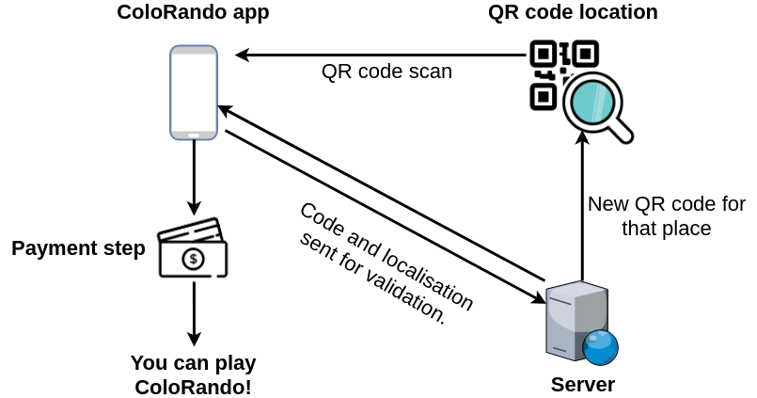

Slide 3
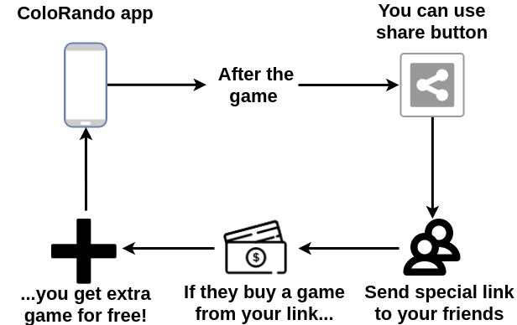

Slide 4
How we came up with this?
Lottery - game of luck not skill.
Gamification.
Geolocalisation.
Social factors.

